Slide 1

Big Mart Sales Prediction
Group-2

Slide 2
Members of Group 2
Vyshnavi Kolla
Vivek Kumar Singh
Shilpi Rani
L. Abhishek
Avinash
Shubham Eragola
Akhila Joseph

Slide 3
Contents
Business Objective
About Dataset
Libraries Used
Exploratory Data Analysis (Eda) & Data Cleaning
Model Building
Deployment
Conclusion

Slide 4
BUSINESS OBJECTIVE
The business objective is to develop a predictive model that accurately forecasts the sales of each product across various stores and outlets.
Using this model, Big Mart will try to understand the properties of products and outlets which play a key role in increasing sales.

Slide 5
ABOUT DATASET
The dataset contains information on the sales of 1559 different products.
These sales records span across 10 different stores.
The sales are presumably recorded over a certain period, possibly daily, monthly, or yearly.

Slide 6
LIBRARIES USED
Pandas: The python library used for working with datasets.
Numpy: Used to perform a wide variety of mathematical operations on arrays.
Seaborn: Used for making statistical graphics in pyhton.
Matplotlib.pyplot: Used for creating static,animated,and interactive visualization.
Scikit-Learn: Also known as sklearn library to implement machine learning models and statistical modelling.

Slide 7
EXPLORATORY DATA ANALYSIS (EDA) & DATA CLEANING
EDA Importance:
EDA visualizes patterns, characteristics, and variable relationships.
Key Libraries: Numpy, Pandas, Matplotlib, Seaborn, Plotly.
Data Cleaning:
Filled Null Values in "Item_Weight" & "Outlet_Size" using "GROUP BY" (based on "Item_Type" & "Outlet_Location_Type").
Outliers Handling:
Identified outliers via boxplots in "Item_Visibility" & "Item_Outlet_Sales".
Used "CLIP" method to remove outliers.

Slide 8
Data Visualization & Feature Engineering
Visualizations:
Highlighted relationships between numerical features.
Comprehensive view with both categorical and numerical features.
Feature Engineering:
Transformed "Outlet_Establishment_Year" to "Outlet_Age" using "datetime."
Introduced "Item_Type_Category" based on "Item_Identifier."
Established distinct groups in "Item_Fat" by "Item_Type."

Slide 9
Feature Importance & Selection:
Utilized random forest regressor to determine significant features.
Created datasets based on importance:
High_Imp_Feature_Dataset
Medium_Imp_Feature_Dataset
Low_Imp_Feature_Dataset
Selected top features for model construction.

Slide 10
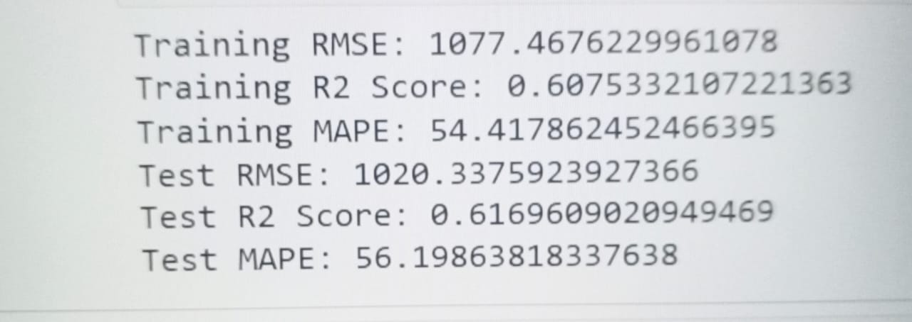
MODEL BUILDING
Model Construction:
Algorithm: Random Forest Regressor
Target Variable: Item_Outlet_Sales
Below shown is the result :

Slide 11
Deployment Essentials:
Generated Files:
model.sav: Contains the trained model.
scaler.sav: Scales features for model use.
This structure allows for efficient utilization and deployment across applications.

Slide 12
DEPLOYMENT
Need of Deployment :
Deploying a model at the end of a project is a crucial step that involves making the model available for use in real-world applications.
Deploying a model using an application(app) provides us several advantages such as making it accessible to a broader audience, Enhanced user experience, Real Time Interaction and Customization.
Libraries Used :
Pandas : Pandas is a popular open-source Python library used for data manipulation and analysis.
Streamlit : Streamlit is a Python library that simplifies the process of creating interactive web applications for data science and machine learning projects.

Slide 13
RandomForestRegressor : The RandomForestRegressor is an implementation of the random forest algorithm for regression tasks in the scikit-learn library in Python.
Scikit-learn : Scikit-learn is a comprehensive and widely-used machine learning library in Python that provides a unified toolkit for various machine learning tasks.
Joblib : A Python library that provides tools for efficient parallel computing and data serialization.
Streamlit.io :Streamlit is a free and open-source framework to rapidly build and share beautiful machine learning and data science web apps.

Slide 14
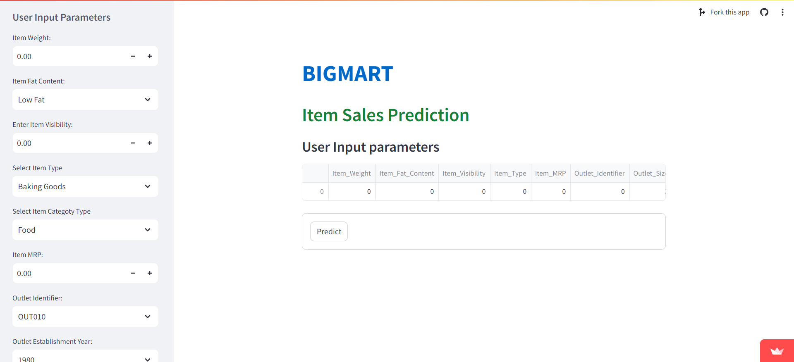
Global Deployment :
Link : https://bigmart-j4jzgxeessegrnnhjqhczg.streamlit.app/

Slide 15
CONCLUSION
With the aid of deployment, we can accurately predict the sales of each product across various stores.

Slide 16



